Slide 1
Introduction
Fossil fuel use is that the primary supply of carbonic acid gas. carbonic acid gas also can be emitted from direct human-induced impacts on biology and different land use, like through deforestation, land clearing for agriculture, and degradation of soils. Likewise, land also can take away carbonic acid gas from the atmosphere through rehabilitation, improvement of soils, and different activities.

Slide 2
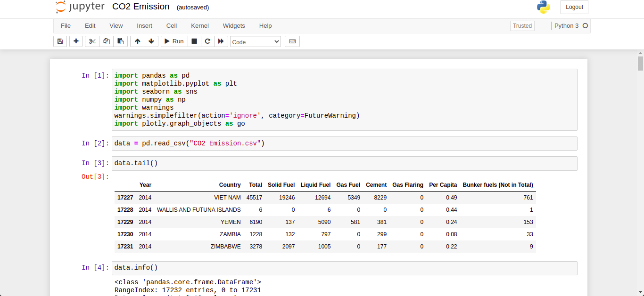
Code to read the data from Excel / CSV / HTML
Pandas has a built in module (read_csv) to read a csv file, read_excel to read an excel file and read_html to read a HTML file.

Slide 3
Code and its output with Explanation

Slide 4
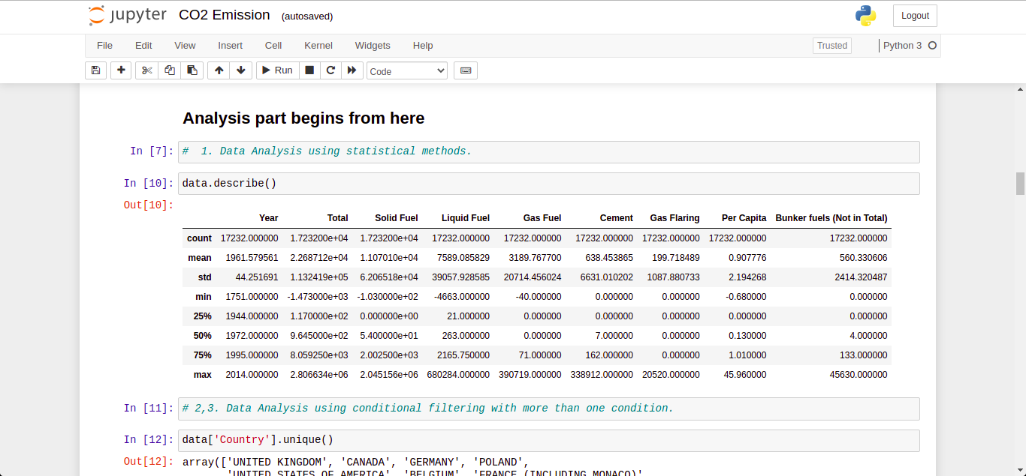
Data Analysis using statistical methods
Here, we find mean, median, mode, count min, max etc using .describe() function

Slide 5
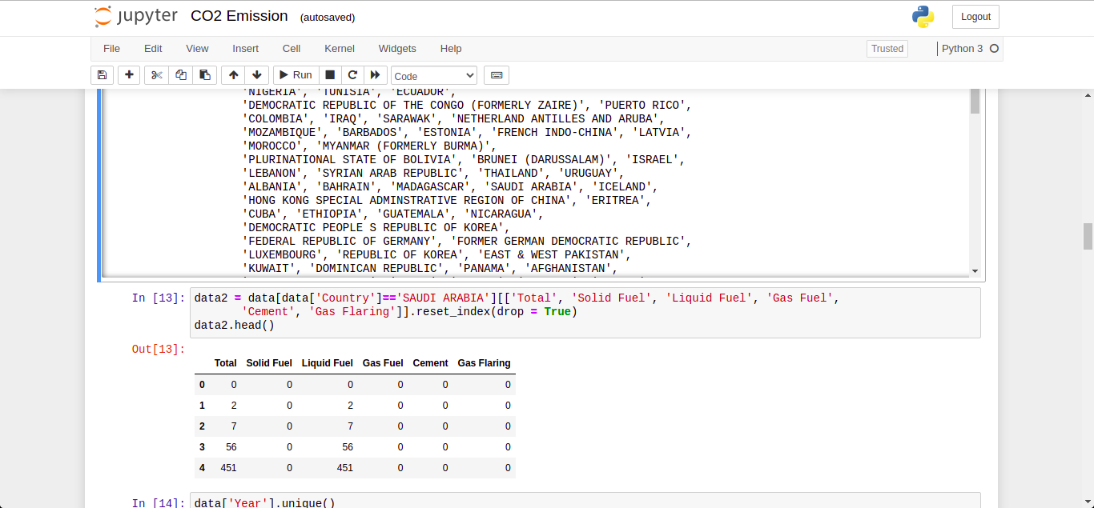
Data Analysis using conditional filtering when Country is Saudi Arabia
Here, we found that there are 208 countries out of which Saudi Arabia has been contributing since 1890.

Slide 6
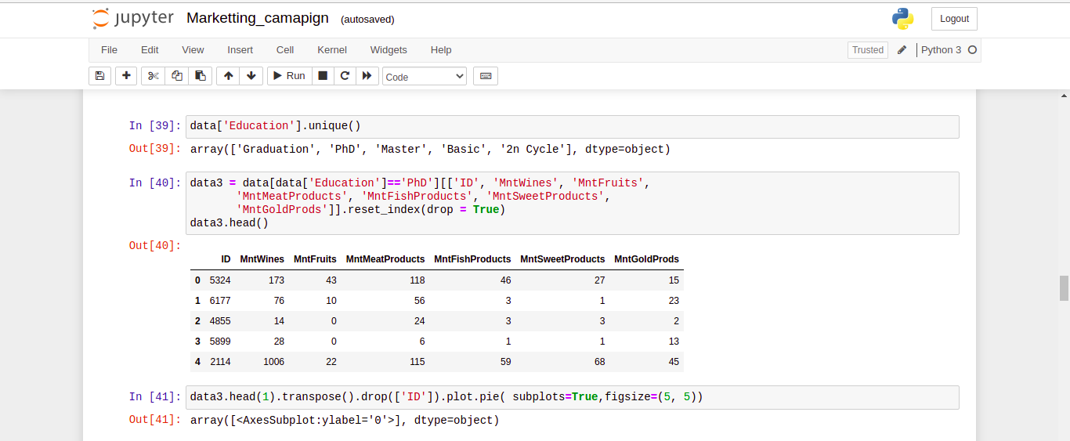
Data Analysis using conditional filtering when Year is 2014.
Here, we filter 2014 data to find out that there’s 200+ countries actively contributing to CO2.

Slide 7
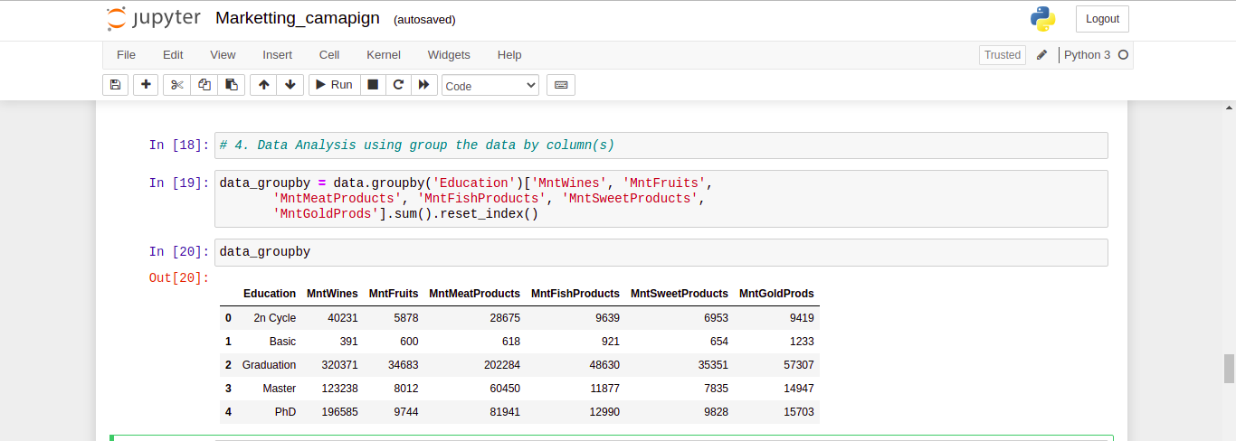
Data Analysis by grouping the data on the basis of Country.
From 1890, till 2014, here’s data of total amount of CO2 every country contributed.

Slide 8
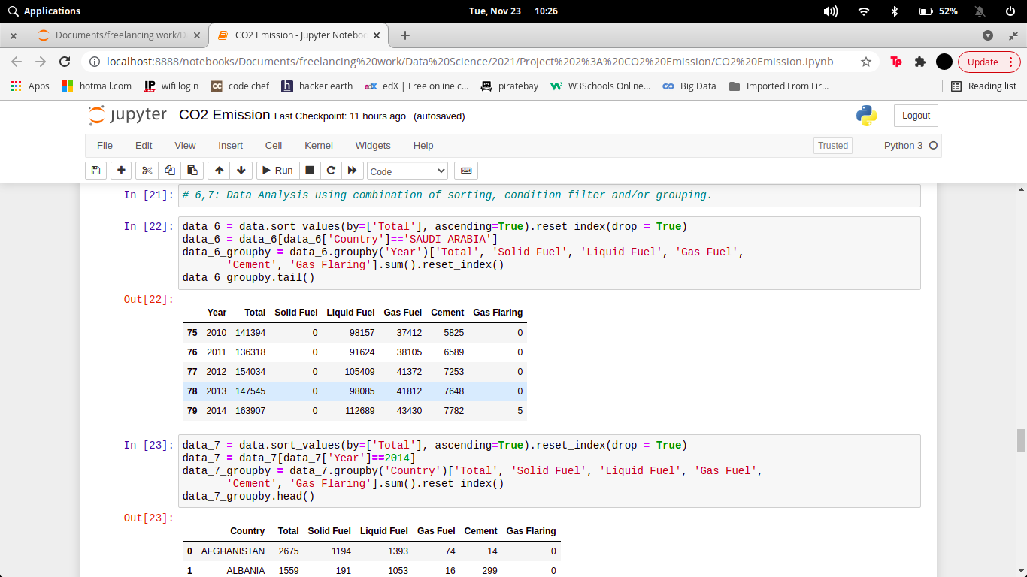
Data Analysis using sorting the data in ascending/descending order.
Here, we sort the data in Ascending order on the basis of year.

Slide 9
Data Analysis after sorting the data on the basis of Total, filtering only Saudi
Arabia and group by on their Year.
Here, first we sort the data according total amount contributed in Ascending order, then filtered it on the basis of Country = Saudi Arabia, and finally group by them on the basis of year.

Slide 10
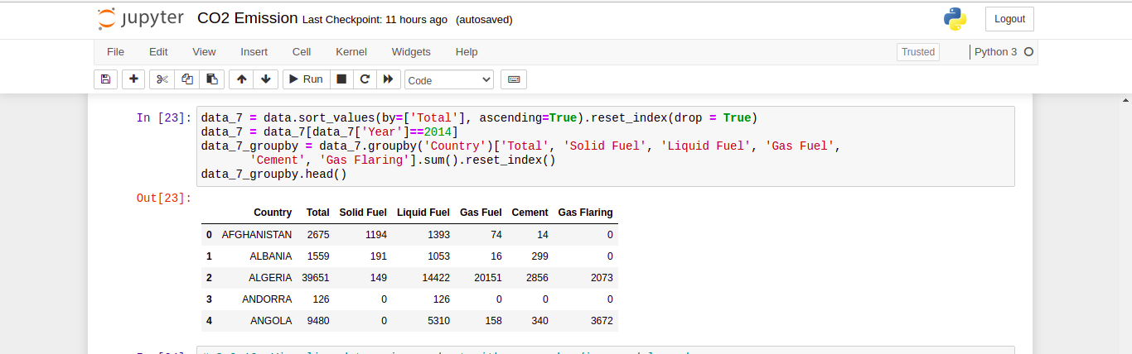
Data Analysis after sorting the data on the basis of Total, filtering ony 2014 data
and group by on the Country.
Here, first we sort the data according total amount contributed in Ascending order, then filtered it on the basis of Year = 2014, and finally group by them on the basis of Country.

Slide 11
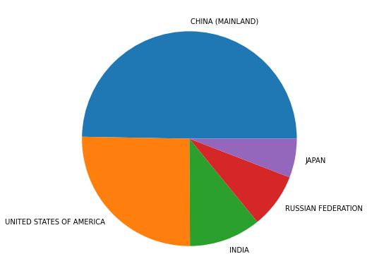
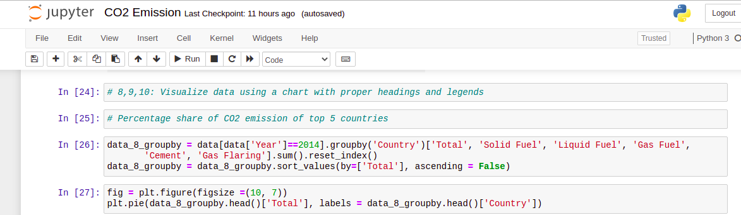
Visualize data of 2014 on the basis of Country using a chart with proper
headings and legends.
This graph shows the % contribution of top 5 countries.

Slide 12
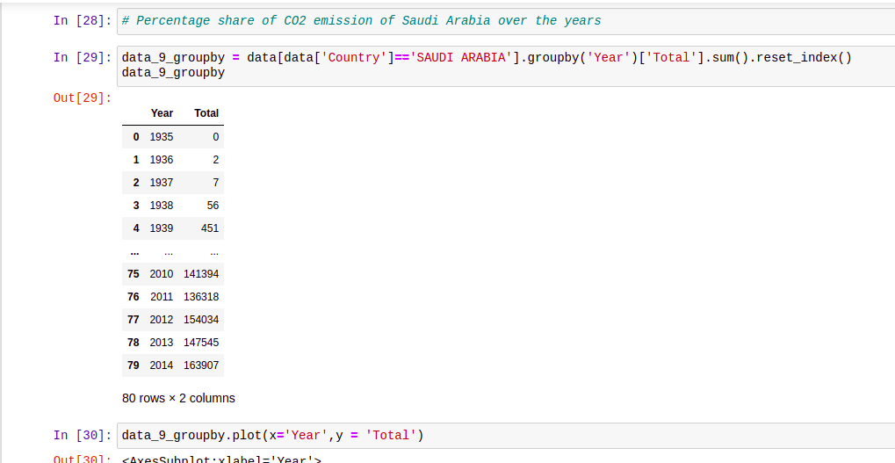
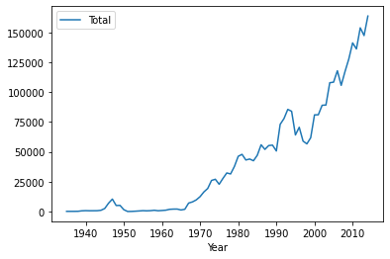
Visualize data of Saudi Arabia on the basis of Year using a chart with proper
headings and legends.
Trending line of Saudi Arabia over the years are shown below:

Slide 13
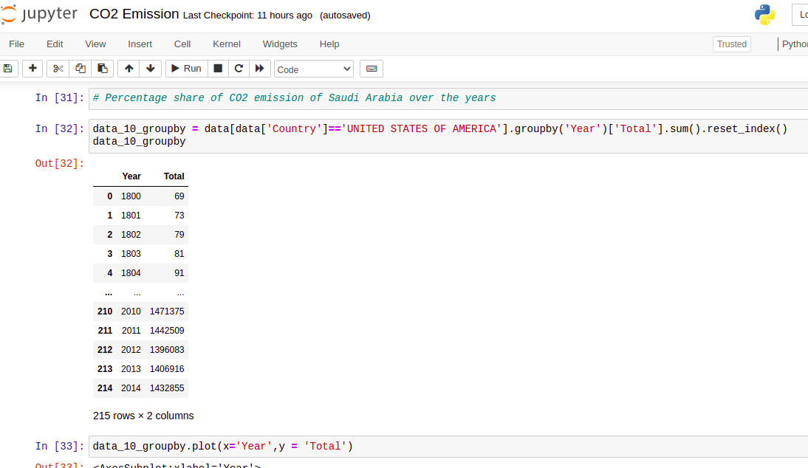
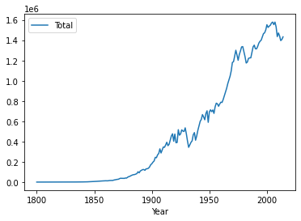
Visualize data of USA on the basis of Year using a chart with proper headings
and legends.
Trending line of USA over the years are shown below:

Slide 14
CONCLUSION
In 2014, the highest dioxide (CO2) emitters were China, the us, the eu Union, India, the Russia, and Japan. These knowledge embrace carbon dioxide emissions from fuel combustion, additionally as cement producing and gas flaring. Together, these sources represent an outsized proportion of total international carbon dioxide emissions.

Slide 15
REFERENCES
https://pandas.pydata.org/docs/
https://www.kaggle.com/ggsri123/co2-emissions-from-fossil-fuels
https://www.w3schools.com/python/pandas/pandas_plotting.asp

